Slide 1
PROJECT PRESENTATION
Object Oriented Concepts -II
(SWE 4301-SWE 4302)
Movie Review System
KHALID HASAN ADOR
210042102

Slide 2
KEY FEATURES
Add New User
Add New Movie
Add Review
Print Movies
Print Users
Print Reviews
Average Rating

Slide 3
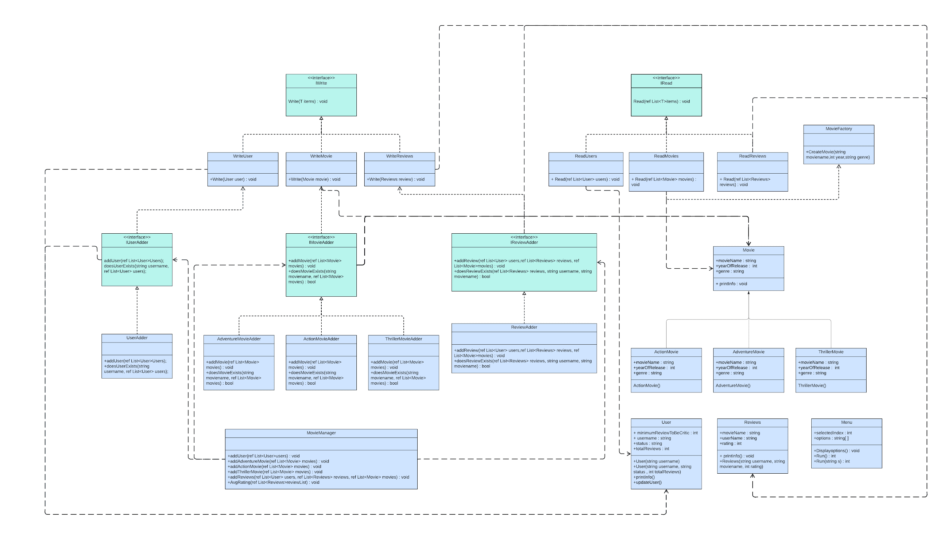
UML

Slide 4
Single Responsibility Principle
In the project, each class is designed to fulfill a specific role. For example, the MovieAdder class only has one responsibility and that is to add Movies. It does so by the addMovie() method. There are no other methods in that class. So the class has only one reason to change.

Slide 5
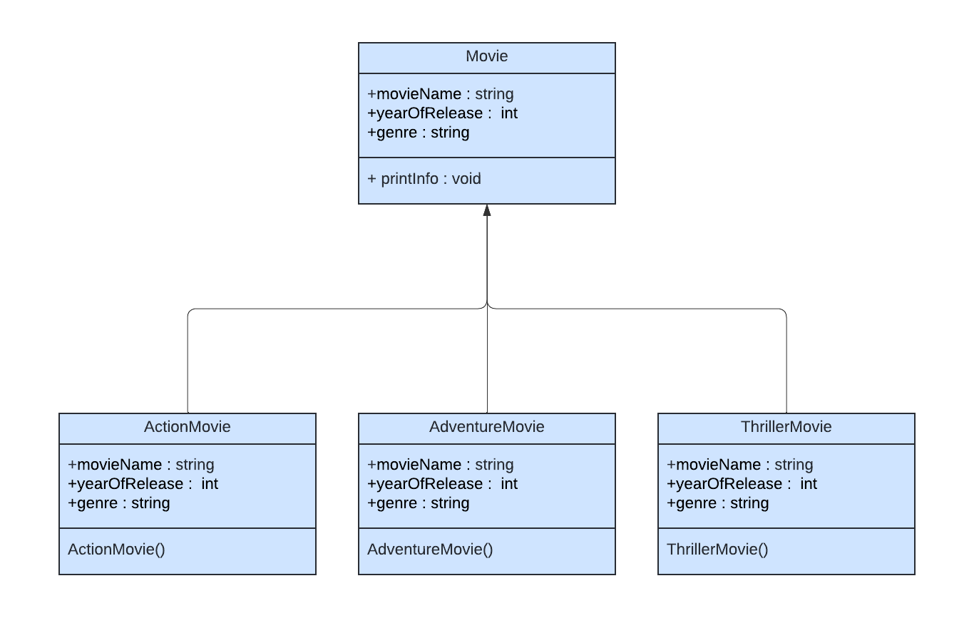
Open Close Principle

Slide 6
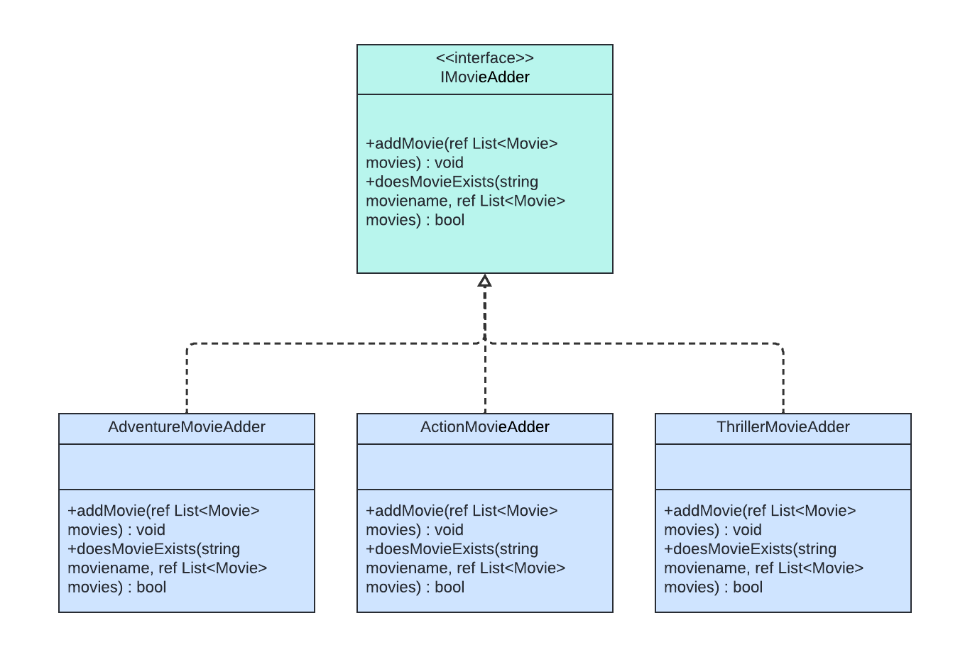
Open Close Principle

Slide 7
Liskov Substitution Principle

Slide 8
Interface Segregation Principle
Classes like AdventureMovieAdder, ActionMovieAdder and ThrillerMovieAdder implements IMovieAdder. But they do use the methods of that interface. So the design follows ISP.

Slide 9
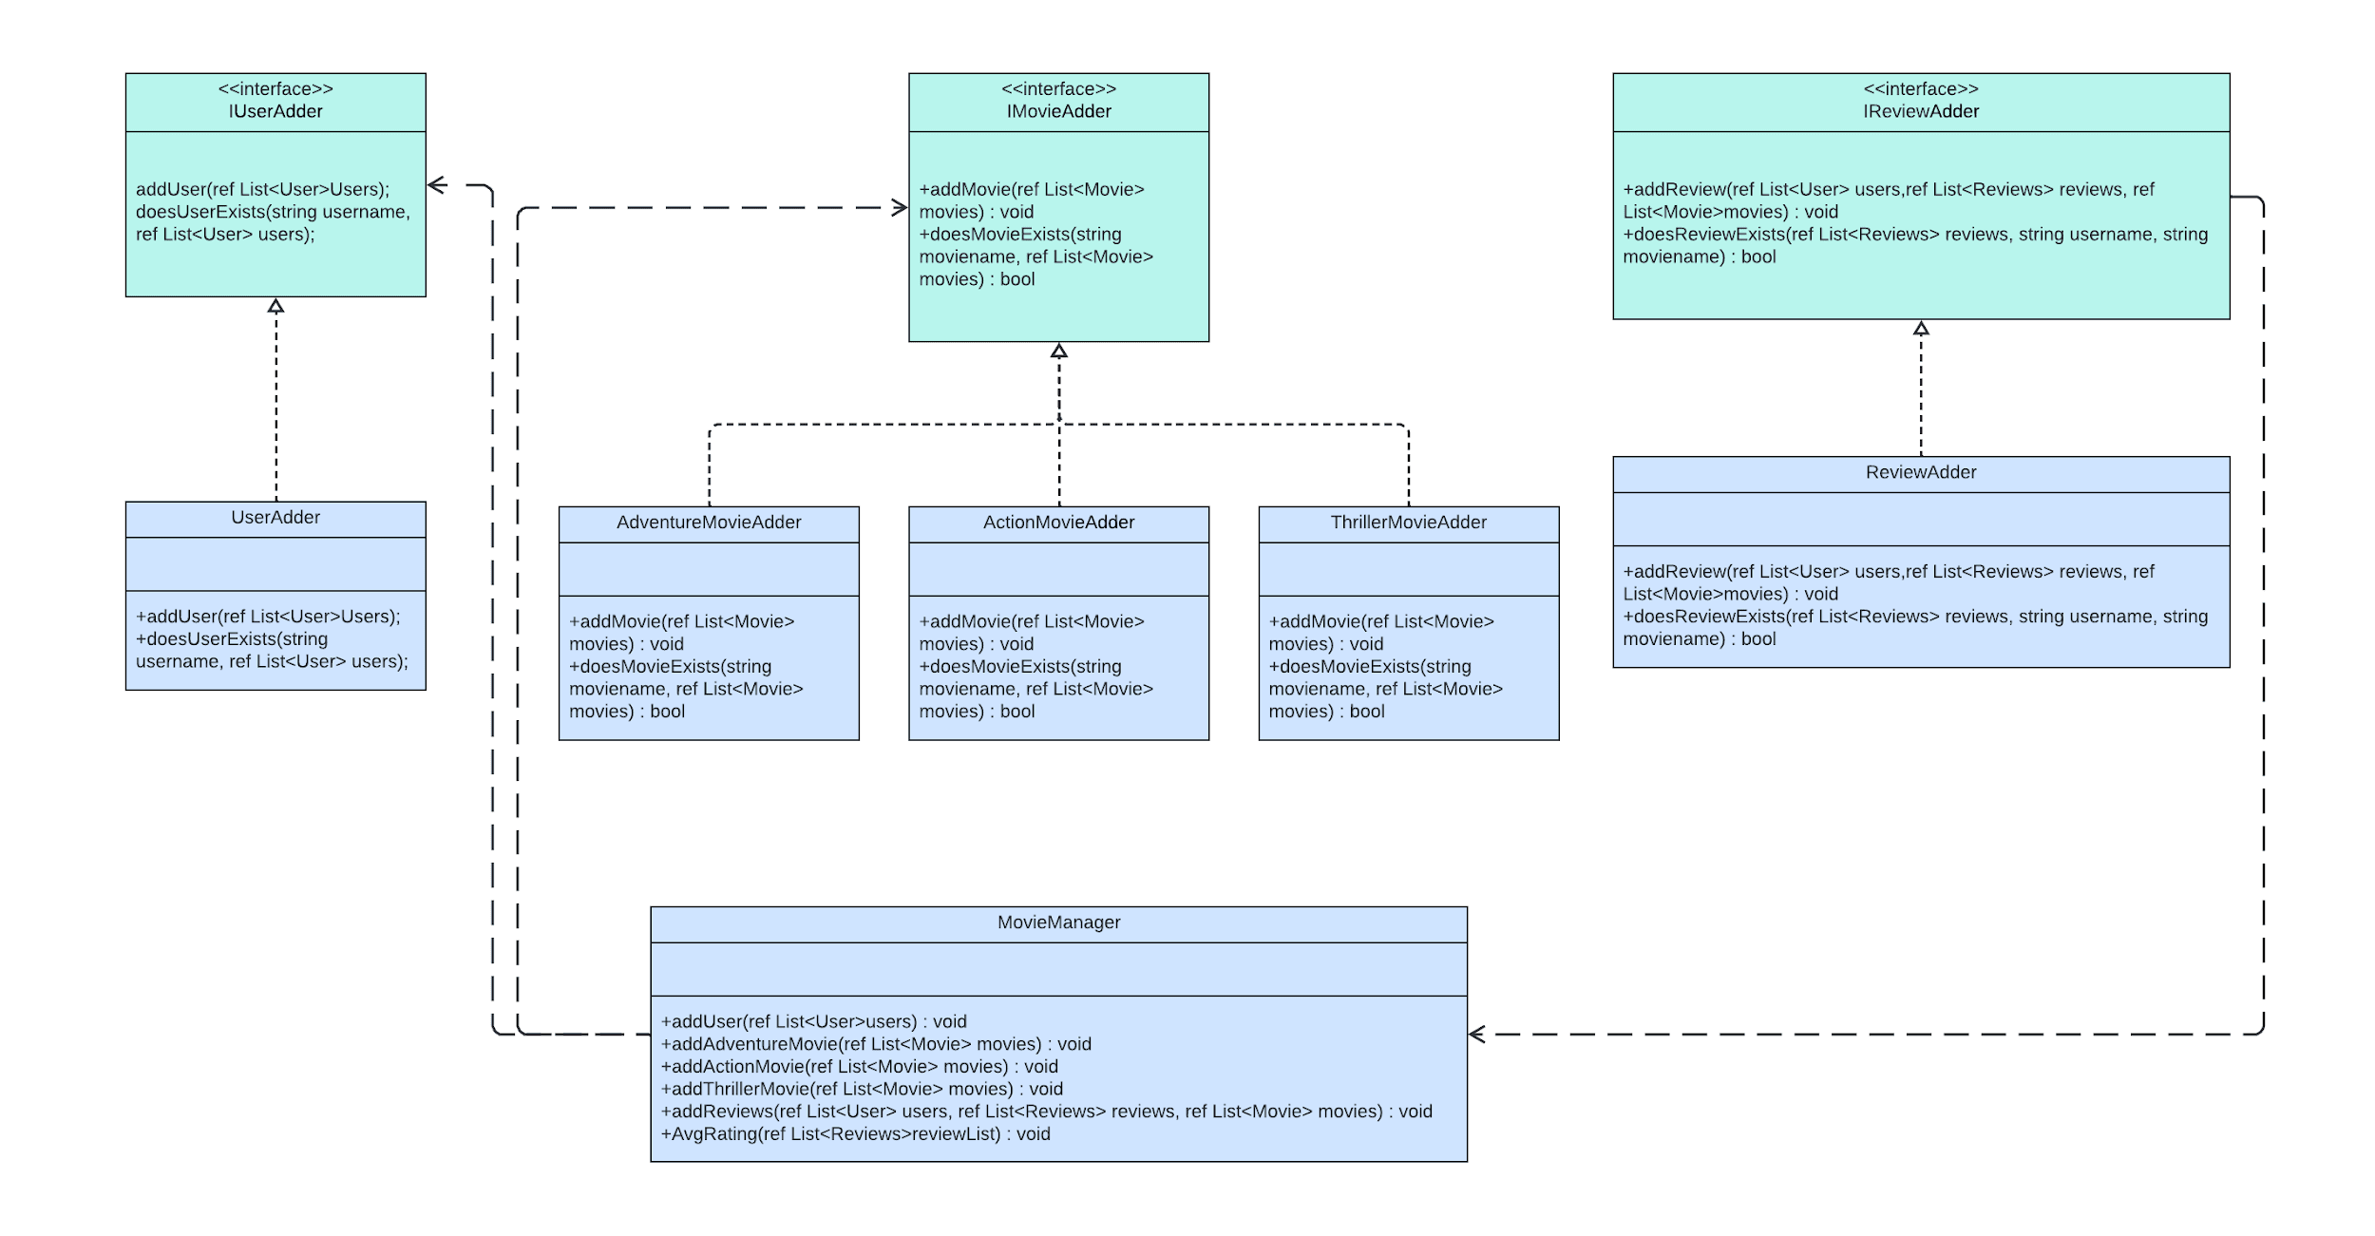
Dependency Inversion Principle

Slide 10
Thank you!

